Slide 1

HygionX - Bridging Artificial Intelligence & Explainable Medicine
By
VAIDYAM LAKSHMI NIHANTH (22BFA33139)
KANDARI MONISHA (22BFA33110)
KUNCHIPALLI CHANDU (22BFA33118)
GIRIRAJU MEHER JAGRUTHI (22BFA33087)
Under the guidance of
Dr P. LOKESH KUMAR REDDY (Ph.D)
DEPARTMENT OF COMPUTER SCIENCE AND ENGINEERING (AI & ML)
SRI VENKATESWARA COLLEGE OF ENGINEERING
(Autonomous)
Karakambadi Road, Tirupati-517507
2022-2026

Slide 2
OUTLINE
Abstract
Introduction
Problem Statement
Existing system
Disadvantages
Proposed system
Advantages
Software Requirements
Hardware Requirements
System Architecture
Modules
UML Diagrams
Output
Future Scope

Slide 3
ABSTRACT
This project presents an AI-powered healthcare chatbot designed to deliver fast, personalized medical support using Natural Language Processing and Machine Learning. Ths system interprets user queries, performs preliminary symptom analysis, and provides suitable recommendations while ensuring explainability for transparent decision-making. Using intent classification, entity recognition, and a curated medical knowledge base, the chatbot generates accurate and context-aware responses. It also has a secure patient record module enables tracking of health history and previous consultations. The system also integrates with external APIs for appointment scheduling, medication reminders, and also follow-up notifications. Overall, this project demonstrates the potential of AI, healthcare informatics, and automation to enhance telemedicine, along with a unique touch of explainability, preventive care, and patient engagement within modern digital healthcare ecosystems.

Slide 4
INTRODUCTION
Healthcare access is often slow and inconsistent, making it difficult for patients to receive timely guidance for common symptoms.
Traditional support systems lack personalization, leading to generic advice and limited continuity of care.
The project HygionX provides an AI-driven solution that uses NLP, ML, and Explainability to analyze symptoms and deliver accurate, transparent medical guidance.
This approach makes healthcare faster, personalized, and more accessible, improving telemedicine and overall patient engagement.
The system supports personalized health insights by leveraging patient history and previous interactions to deliver more relevant and context-aware recommendations

Slide 5
PROBLEM STATEMENT
Existing healthcare chatbots do not consider patient medical history, leading to incomplete or generic responses.
Most systems provide answers without explainability, creating trust issues for users.
They also struggle with complex or rare medical cases, and cannot guide users reliably in such situations.
Most of the existing chatbots donot predict the triage efficiently, leading to a gap in medical analysis
Therefore, there is a need for a chatbot that offers personalized, explainable, and history-aware medical support, bridging the gaps in existing solutions.

Slide 6
EXISTING SYSTEM
Current healthcare chatbots such as Babylon Health, Buoy Health, and Ada Health mainly focus on general symptom checking, while platforms like Wysa, Woebot, and Replika provide emotional or mental-health support. Similarly, bots like Florence and Molly assist users with medication reminders and chronic condition management, and hospital-specific chatbots from institutions like the Mayo Clinic and Cleaveland Clinic offer basic medical guidance for their patients. However, these systems largely rely on static question-answer flows and do not integrate a user’s complete medical history while generating responses. Most existing chatbots operate reactively, responding only when asked, and lack features such as multilingual support, deep personalization, or transparent explainability of their answers. As a result they often struggle with complex or rare medical cases, and fail to establish the trust due to limited reasoning visibility and weak integration with patient records or healthcare systems.

Slide 7
DISADVANTAGES
Uses basic symptom matching without considering the deeper medical context.
Limited adaptation to individual patient differences.
No continuous patient profile or long-term memory.
Reasoning behind responses is not clearly explained.
Accuracy drops for complex or rare medical cases.
Language support is restricted, reducing accessibility.
Weak integration with hospitals or medical systems.

Slide 8
PROPOSED SYSTEM
The proposed system introduces HygionX, an AI-powered healthcare chatbot that combines user medical history with real-time symptom inputs to deliver personalized and reliable guidance. It uses HuggingFace transformers like MiniLM for sentence transformations and SciSpacy NER transformer for efficient symptom recognition. And the system acts by predefined secure rules with preprocessed data, return a JSON output. A secure MySQL database maintains user profiles and past records, enabling continuity across sessions. The system incorporates to highlight important factors, reasoning, and confidence levels behind every prediction, improving trasparency and trust. HygionX also aims to support accurate disease prediction using pre trained models, update user history after each session, and also trigger a “consult doctor” recommendation when confidence falls below a threshold, ensuring safe and responsible usage.

Slide 9
ADVANTAGES
Personalized medical guidance
History-aware responses
Explainable and transparent outputs
Higher accuracy in answers
Safe, confidence-based suggestions
Continuous user data updates
Scope of updation of user data
Secured user data in efficient databases
Firebase Authentication

Slide 10
SOFTWARE REQUIREMENTS
Operating System : Windows 10/11
Browser : Google Chrome/ Firefox
Programming language : Python
Frontend : HTML, CSS, JS
Backend Framework : Flask (REST API)
Databases : MySQL - user records
Authentication : Firebase
NLP/ML Libraries : PyTorch, HuggingFace Transformers
Development Tools : VS Code, Google Colab, Jupyter Notebook
Version Control : Git, GitHub

Slide 11
HARDWARE REQUIREMENTS
Processor : Intel Core 2 Duo / i3 Processor (1.8 GHz or higher) RAM : 4GB minimum (8GB recommended)
Hard disk : 20 GB or more Display : Standard HD Monitor
Keyboard : Standard 104-keys keyboard Mouse : Optical mouse
Internet : Stable broadband connection

Slide 12
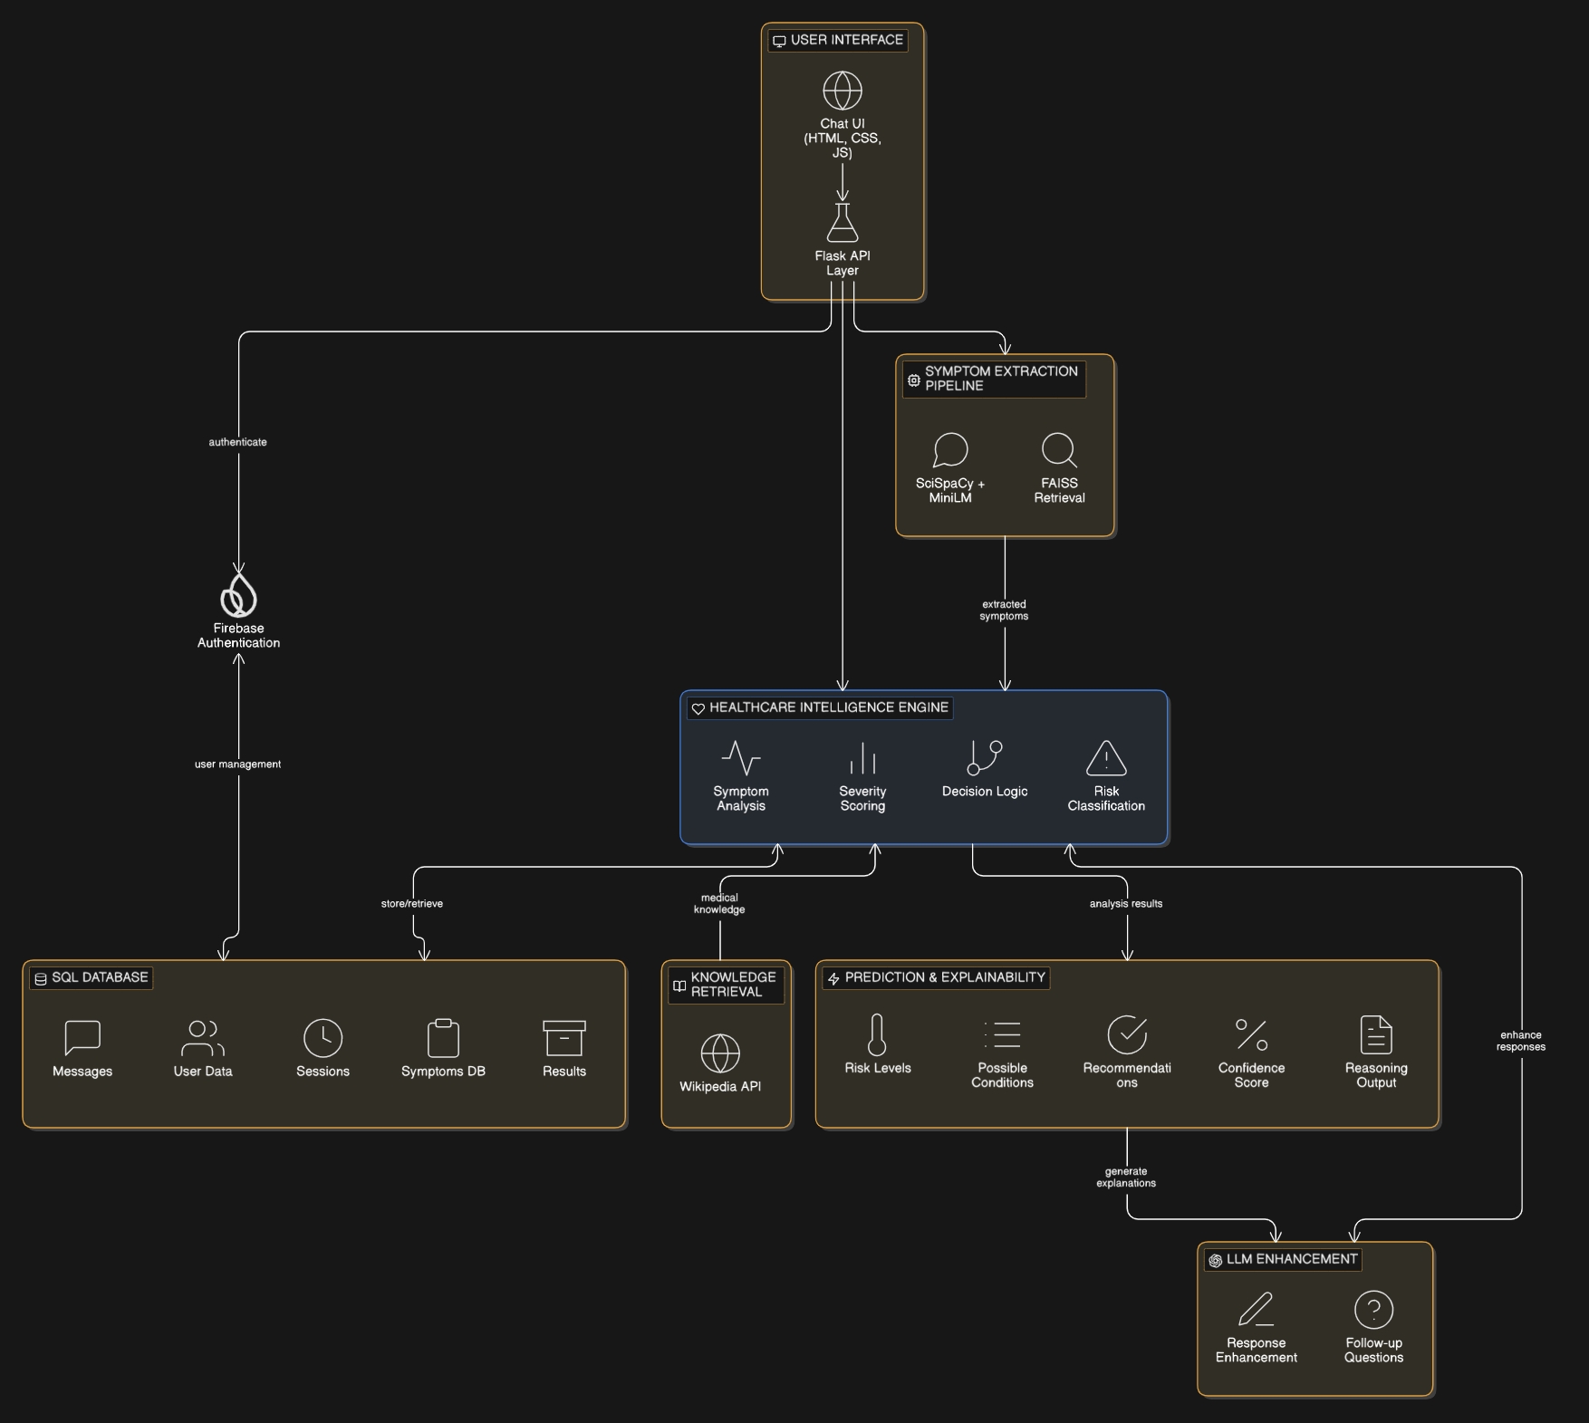
SYSTEM ARCHITECTURE

Slide 13
SYSTEM ARCHITECTURE
The system follows a modular client-server architecture, separating the user interface, backend processing, and data storage layers to ensure scalability and maintainability.
The application provides a web-based chat interface for user interaction, with secure authentication and user management handled through Firebase Authentication.
A Flask-based backend API manages request handling, session management, and communication between system components, enabling smooth data flow.
The core Healthcare Intelligence Engine processes user inputs using NLP and ML techniques, including symptom extraction and triage logic for severity assessment and risk classification.
User data, chat history, detected symptoms, and triage results are stored in a structured SQL database, while external services such as knowledge retrieval APIs and optional LLM modules enhance system functionality and responses.

Slide 14
MODULES
User Module
Admin Module
Authentication & User Management Module
Conversation & Session Management Module
Knowledge Retrieval Module
Healthcare Intelligence Engine Module
Database & Infrastructure Module

Slide 15
MODULES
User Module:
The User Module allows patients to interact with the HygionX system through a web-based chat interface. Users can register and login securely to access the platform. They can enter symptoms in natural language and receive AI-generated healthcare guidance. The module also displays responses with explanations and suggested actions. Additionally, users can view past interactions and manage basic profile information. This ensures a smooth and personalized user experience.

Slide 16
MODULES
Admin Module:
The Admin Module is responsible for managing and monitoring the overall system operations. It allows administrators to oversee user activity and system performance. The module helps in maintaining datasets, configurations, and backend services. It ensures that the system runs efficiently without disruptions. It also supports monitoring of stored medical data and system outputs. This contributes to reliability and proper system maintenance.

Slide 17
MODULES
Authentication & User Management Module:
This module handles secure user authentication and account management. It enables users to register and login using a secure authentication system. User details such as name, age, gender, and known conditions are stored safely. The module ensures proper access control and protects user data. It also supports personalized experiences based on user profiles. This improves both security and usability of the platform.

Slide 18
MODULES
Conversation & Session Management Module
This module manages the entire interaction flow between the user and the system. It maintains session continuity by storing chat history and context. Each message is recorded and linked to a session for better tracking. The module keeps track of detected symptoms across multiple messages. It ensures that follow-up questions are relevant and meaningful. This improves the accuracy and consistency of responses.

Slide 19
MODULES
Knowledge Retrieval Module
The Knowledge Retrieval Module provides additional medical information to users. It retrieves disease-related details from external sources such as medical databases or APIs. The module presents this information in a simplified and user-friendly format. It helps users understand conditions beyond just predictions. It also enhances the overall learning experience for the user. This makes the system more informative and supportive.

Slide 20
MODULES
Healthcare Intelligence Engine:
This is the core AI-driven component of the HygionX system. It processes user input using NLP techniques to extract relevant symptoms. The module analyzes severity levels and identifies possible conditions. It generates risk classifications such as low, moderate, or high. It also provides recommended actions and basic explanations for the results. This ensures accurate, explainable, and useful healthcare guidance.

Slide 21
MODULES
Database & Infrastructure Module:
This module is responsible for handling data storage and system infrastructure. It stores user profiles, chat history, detected symptoms, and triage results. The system uses a structured database to maintain consistency and reliability. It supports efficient retrieval of past data for continuity. The architecture is designed to handle failures gracefully without breaking the system. This ensures scalability, stability, and long-term usability.

Slide 22
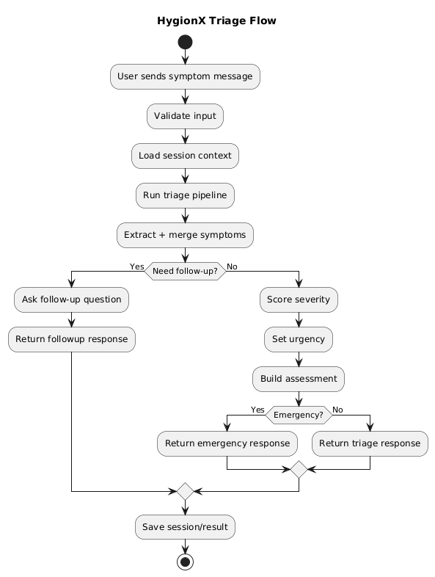
UML DIAGRAMS

Slide 23
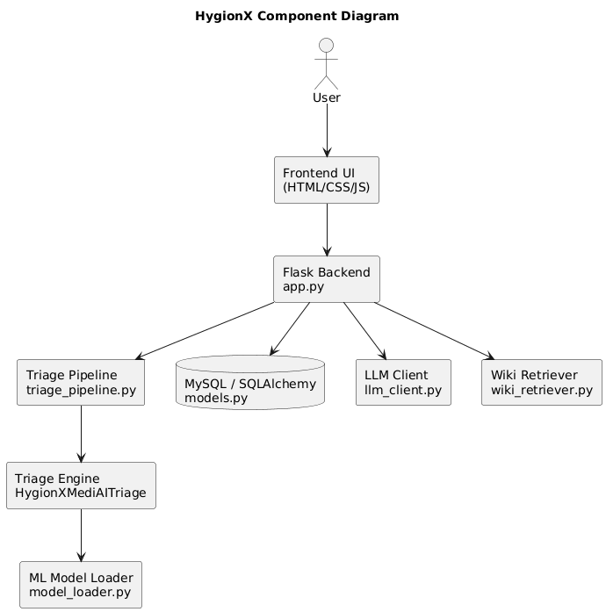
UML DIAGRAMS

Slide 24
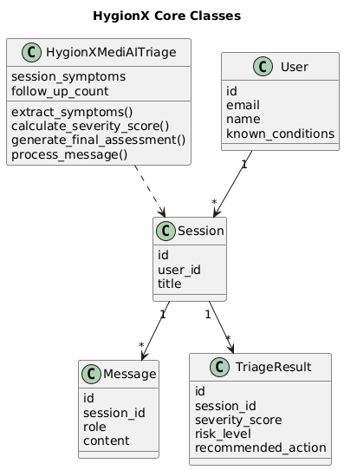
UML DIAGRAMS

Slide 25
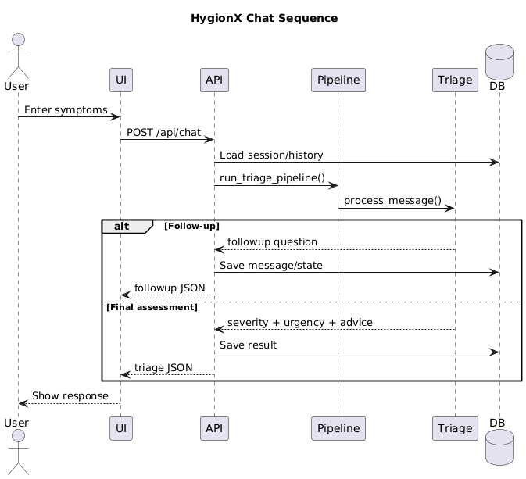
UML DIAGRAMS

Slide 26
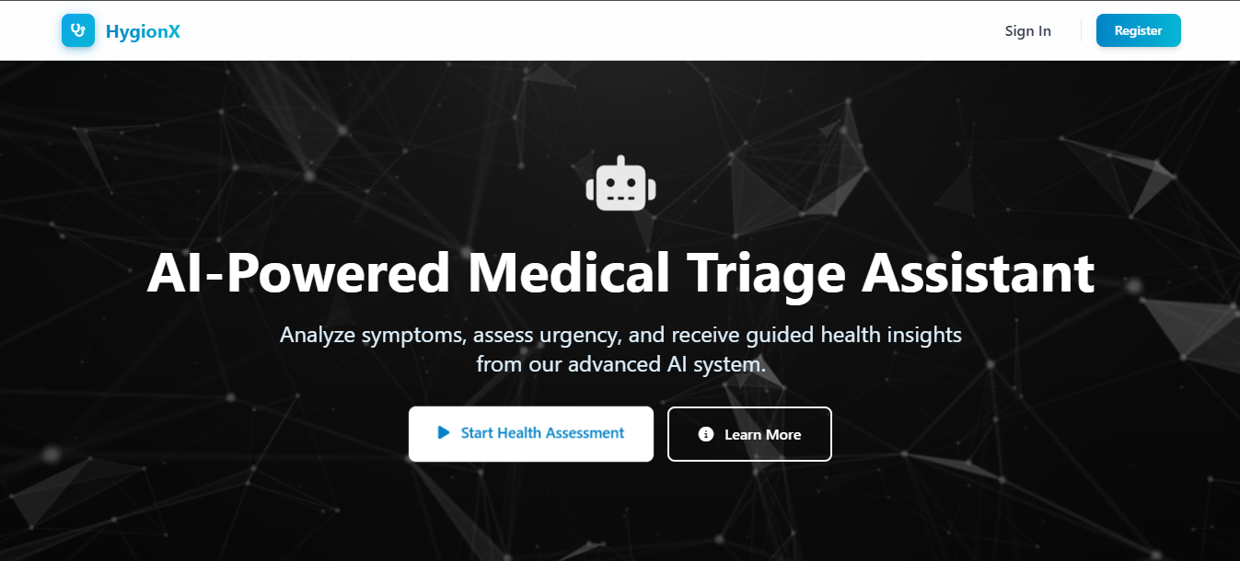
OUTPUT
Landing Page

Slide 27
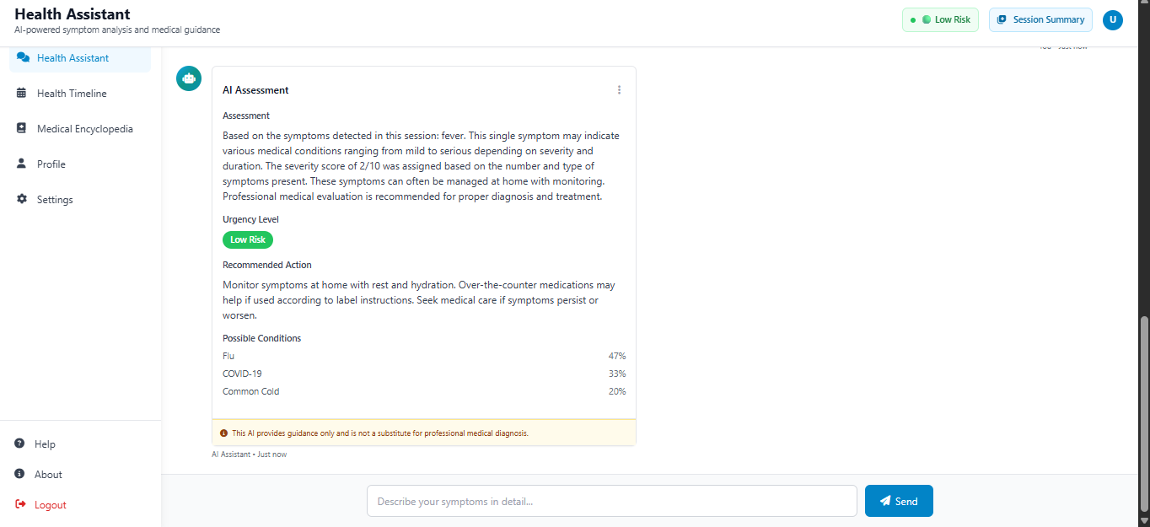
OUTPUT
Health Assistant

Slide 28
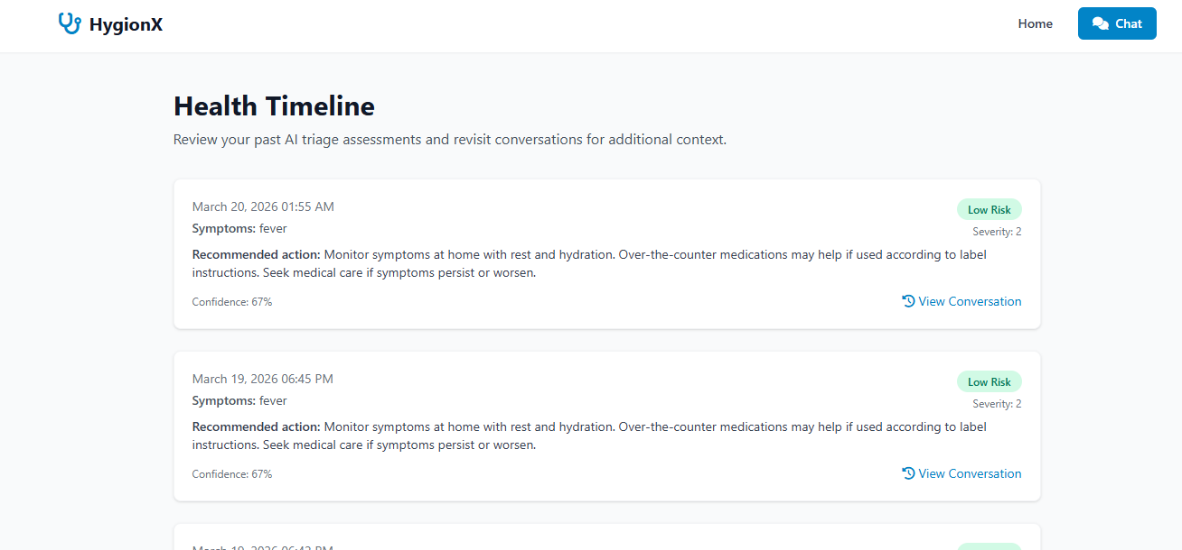
OUTPUT
Health Timeline

Slide 29
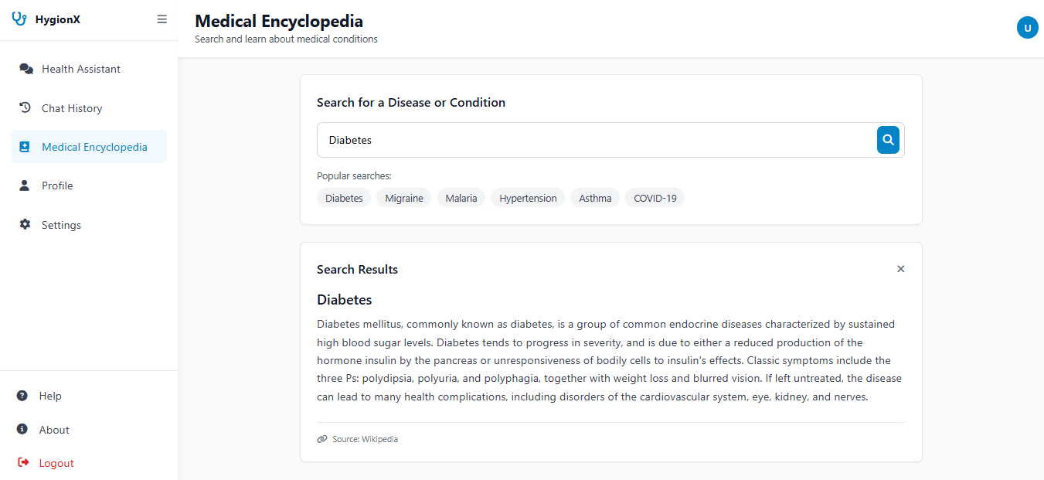
OUTPUT
Medical Encyclopedia

Slide 30
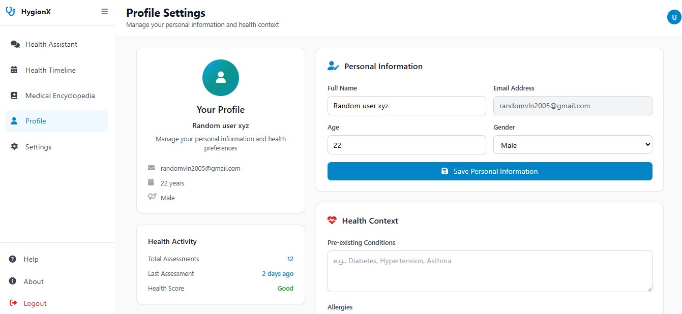
OUTPUT
User Profile

Slide 31
FUTURE SCOPE
The system can be enhanced by integrating voice-based interaction to allow users to describe symptoms through speech, improving accessibility and ease of use.
Advanced machine learning models can be incorporated to improve prediction accuracy and support more complex medical conditions and personalized recommendations.
Integration with wearable devices and real-time health monitoring systems can enable continuous tracking of patient health data.
The platform can be extended to include direct doctor consultation, appointment booking, and telemedicine support for complete healthcare assistance.

Slide 32


